Slide 1


BANKING MANAGEMENT SYSTEM

Slide 2


Team Members
R.P. AADITYA
S.DINESH KRISHNA
A.KAMLESH
J. GODWIN

Slide 3

INTRODUCTION
Use for saving the databases of clients and staffs of bank.
Accounts are saved with their own particular id.
Accounts can be searched with their detail information.
Transactions can also be saved and view effectively whenever needed.
Provides effective interest calculation for the deposited money of client and automatically added into total amount in daily balance.

Slide 4


PROBLEM DESCRIPTION
The bank management system is an application for maintaining a person's account in a bank. The system provides the access to the customer to create an account, deposit the cash from his account, also to view reports of all accounts present. The following presentation provides the specification for the system.

Slide 5
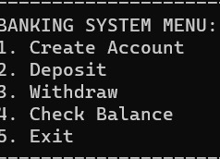
MODULE

Slide 6
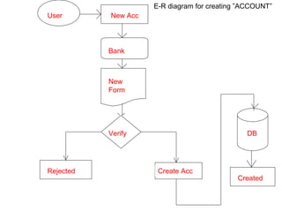
ER DIAGRAM

Slide 7
CONCLUSION
This project is developed to nurture the needs of a user in a banking sector by embedding all the tasks of transactions taking place in a bank.
Future version of this software will still be much enhanced than the current version 1.0.Thus the Bank Management System it is developed and executed successfully.

Slide 8

THANK YOU

